Slide 1

SES/SRM Webinar Presentation 5
Supporting SECU Investigations

Slide 2
Outline
Overview of SECU
Scope of Mandate
How Requests are Filed and Handled
  Roles of Country Offices
  Additional resources and request for feedback

Slide 3
Overview
SECU’s purpose: Ensure UNDP’s compliance with its social and environmental commitments, to support sustainable and just development
Not designed to assign blame to any individual

Slide 4
Overview - Continued
SECU performs investigations when it has evidence that UNDP may not be meeting its social and environmental commitments, and local communities or individuals have been - or may be – harmed
Investigations can be triggered by requests from these communities, by the Lead Compliance Officer, or by the Administrator
Housed within the Office of Audit and Investigations
Report findings and recommendations to the UNDP Administrator, who decides how to respond

Slide 5
Scope of Mandate
Investigate project and programme activities supported by funding through UNDP accounts
NIM and DIM
Full investigations of projects or programmes approved on or after 1 January 2015
Advisory review

Slide 6
How Requests are Filed
SECU’s dedicated online submission form
Email to SECU secuhotline@undp.org
Telephone – SECU Hotline
If a CO receives a request for compliance review, forward it to OAI/SECU

Slide 7
Relationship to
Stakeholder Response Mechanism (SRM)
SECU
SRM
Request for Help
SRM//CO and SECU notified, and determine if it is a SECU or SRM request

Slide 8
How SECU Handles Requests
Request for
SECU
Criteria
Met?
TOR
Fact Gathering
Findings and Recommendations
Decision by Administrator

Slide 9
Possible Administrator Responses
Modifications to UNDP approach to Project
Withholding support pending measures for compliance
Stopping disbursements when harm is found and compliance is not possible
No action

Slide 10
Role of UNDP Country Office
Informing local communities about the project and SECU
Supporting SECU investigations
Bringing the project into compliance and supporting monitoring of activities

Slide 11
Role of UNDP Country Office – cont’d
Informing local communities about the project and SECU
  Make project information available and accessible
  Consult communities on project
  Provide information about SECU

Slide 12
Role of UNDP Country Office – cont’d
Supporting SECU investigations
  Make documents available
  Assist UNDP staff in establishing contacts
  Support meetings in the course of SECU field visits

Slide 13
Role of UNDP Country Office – cont’d
Bringing the project into compliance and supporting monitoring of activities
  Work with partners to implement measures identified by Administrator
  Monitor implementation of measures
  Report on progress
  Continue relationship with stakeholders

Slide 14
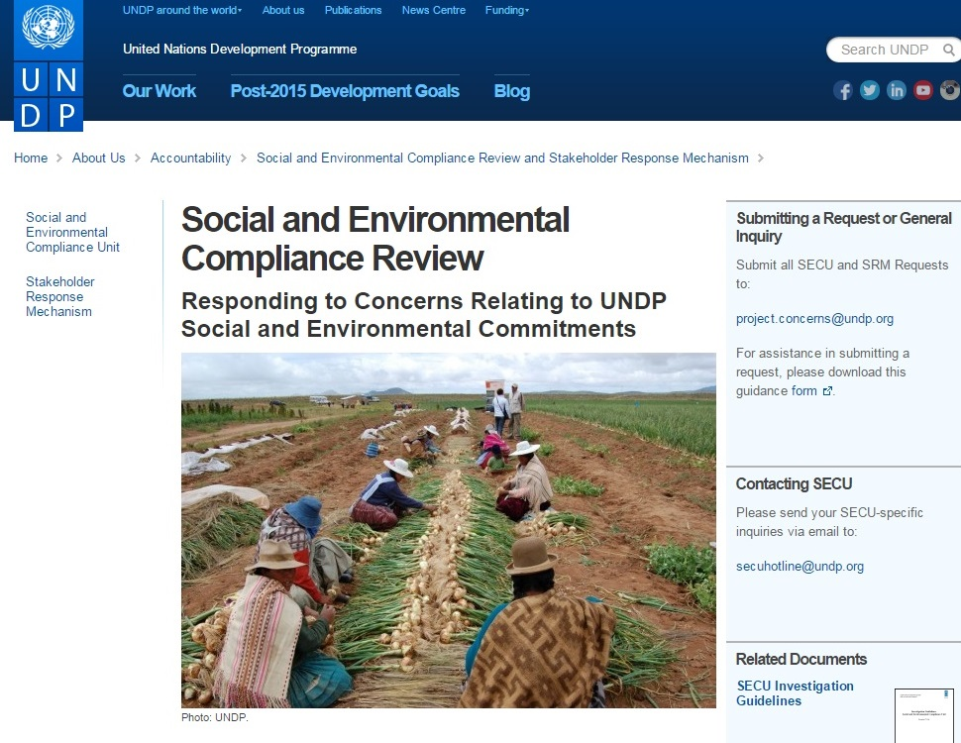
Learn More
SECU/SRM Public Website: www.undp.org/secu-srm
SECU-specific Public Website: www.undp.org/secu
SES Toolkit: intranet.undp.org/unit/bpps/DI/SES_Toolkit
SES Public Website: www.undp.org/ses

